Slide 1


Slide 2


Slide 3
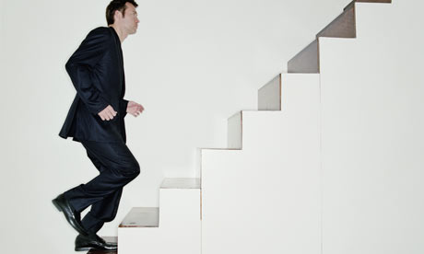

Slide 4


Slide 5
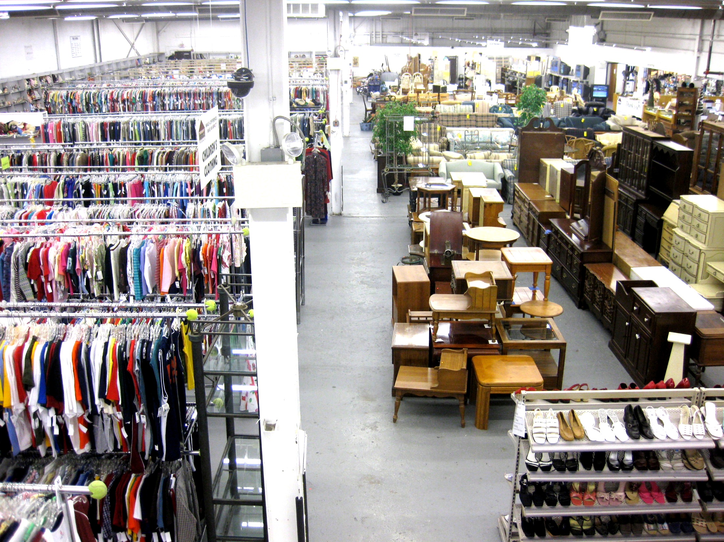
Front

Slide 6
Back

Slide 7
Left

Slide 8
Right

